Slide 1
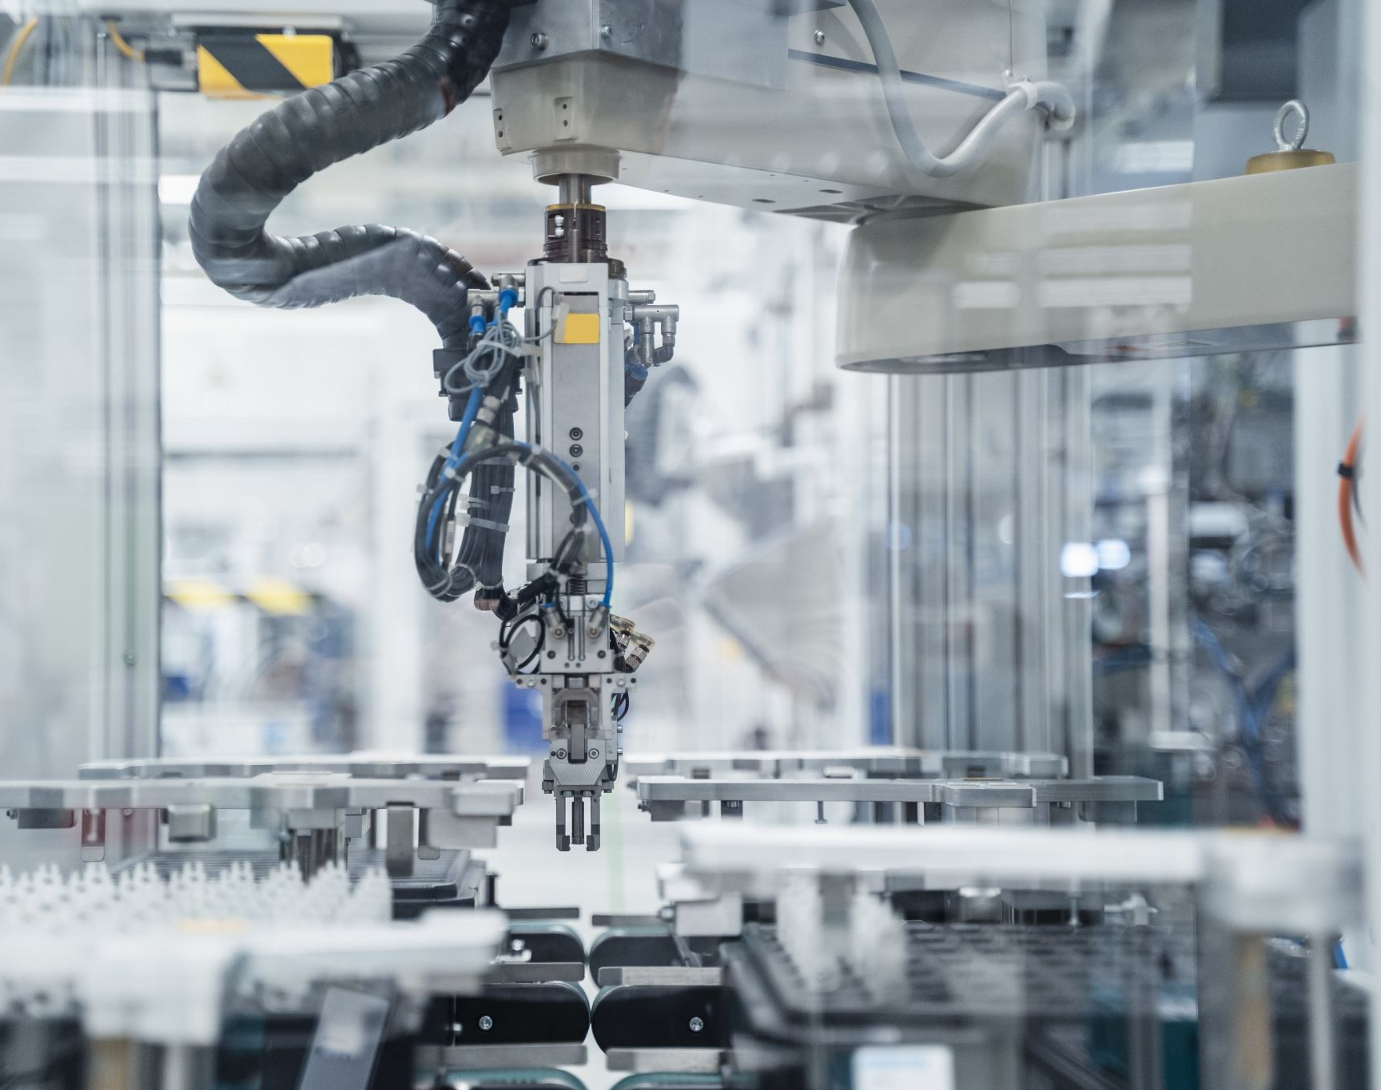
SUPPLY CHAIN 101 AND THE IMPACT ON THE AUTOMOTIVE INDUSTRY
PRESENTED BY BOB ARMSTRONG FCILT, PRESIDENT THE CHARTERED INSTITUTE OF LOGISTICS & TRANSPORT IN NORTH AMERICA AND A MEMBER OF THE MINISTER OF TRANSPORT’S NATIONAL SUPPLY CHAIN TASK FORCE

Slide 2
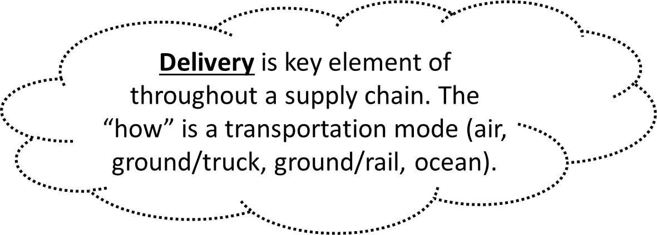
WHAT IS A SUPPLY CHAIN???
A supply chain is the network of all the individuals, organizations, resources, activities and technology involved in the creation and sale of a product.
A supply chain encompasses everything from the delivery of source materials from the supplier to the manufacturer through to its eventual delivery to the end user.

Slide 3
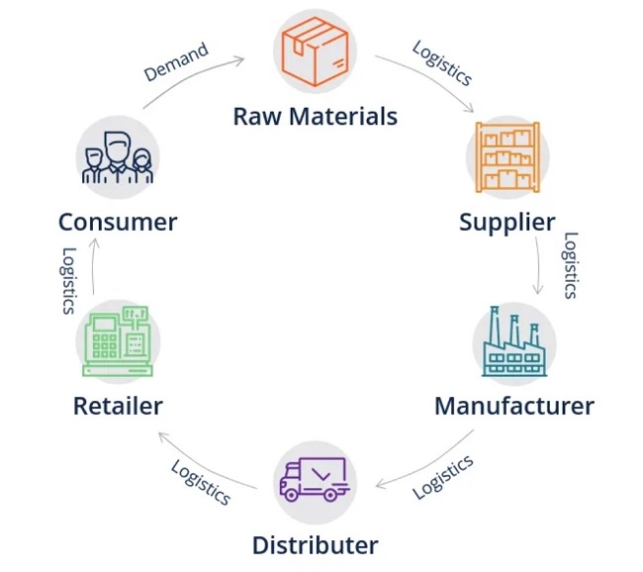
A SUPPLY CHAIN IS A NETWORK…
A supply chain is a network between a company and its suppliers to produce and distribute a specific product to the final buyer. This network includes different activities, people, entities, information, and resources. The supply chain also represents the steps it takes to get the product or service from its original state to the customer.
Companies develop supply chains so they can
reduce their costs and remain competitive in the business landscape.
There are 2 types of supply chains. Global and Local Supply Chains.

Slide 4
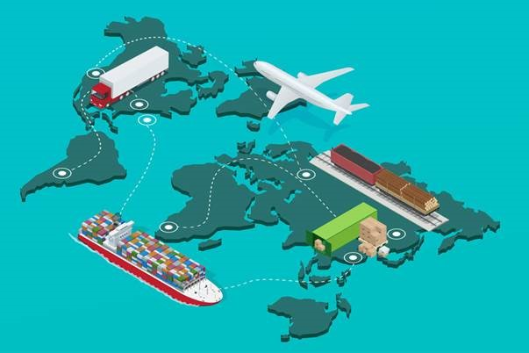
WHAT IS THE DIFFERENCE……
Global supply chains
A global supply chain will usually flow from an organisation in its home country as a buyer across its supplier tiers; it’s these suppliers who will be located in other areas of the globe. In the automotive industry there are OEMs in Canada, USA, Mexico, Germany, Japan, South Korea and UK. OEM parts are also acquired from these OEMs for the Canadian market.

Slide 5
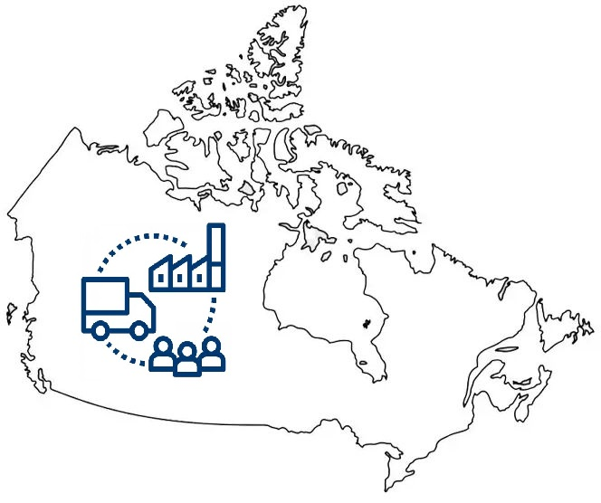
LOCAL SUPPLY CHAINS
Local supply chains
A local supply chain will look to optimise suppliers who are regional to an organisation. In some instances, organisations will look to leverage “home grown” supply routes. This means many suppliers feeding into the supply chain will be located within the country in which the OEM is based, or the supply chain can be even closer to the organisation. The Auto industry in Canada uses OEM parts suppliers locally , as well as, importing especially from the USA.
It may even be within the same municipality or province, which often gives a clearer visibility of the whole supply chain from raw material through to consumer.

Slide 6
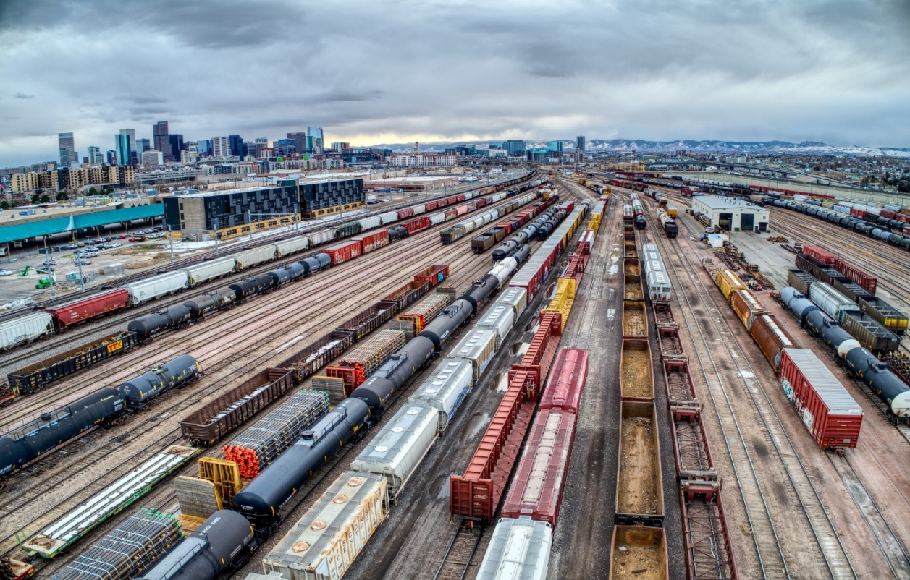
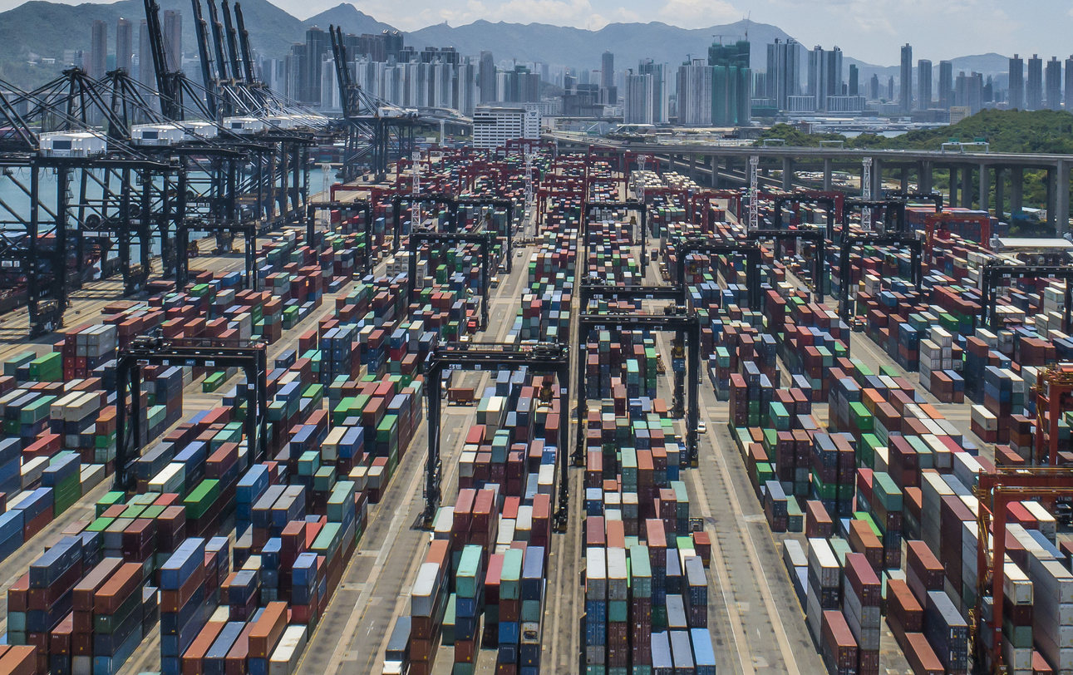
THE SUPPLY CHAIN HAS BEEN A MESS Minister of Transport formed a National Supply Chain Task Force (NSCTF)

Slide 7
VIEW OF NORTH AMERICAN OEM’S TO THE NSCTF
-CANADA’S COMPETITIVENESS AS AN INVESTMENT DESTINATION DEPENDS ON THE AUTO INDUSTRY’S ABILITY TO EFFICIENTLY MOVE GOODS ACROSS CANADA, AS WELL AS, INTO AND OUT OF CANADA
VEHICLES ARE 2ND LARGEST CANADIAN EXPORT BY VALUE AT $36 BILLION IN 2021
DELAYS OR DISRUPTIONS IN THE SUPPLY CHAIN HAVE AN IMMEDIATE EFFECT ON PRODUCTION, TRADE, DEALERS AND CONSUMERS!

Slide 8
COVID-19 IMPACT- GLOBAL CHIP SHORTAGE
THE GLOBAL SEMICONDUCTOR SHORTAGE SQUEEZED THE SUPPLY OF MICROCHIPS FOR THE PRODUCTION OF CARS AND TRUCKS IN 2021 AND 2022
SLOW, GRADUAL RECOVERY 4TH QUARTER 2022
MAJOR SHIFT TOWARDS AUTOMATION AND ELECTRIC VEHICLES THAT REQUIRE MORE MICROCHIPS AND FURTHER STRAIN ON SUPPLY CHAIN SYSTEM

Slide 9
WHAT’S 2023 LOOK LIKE FOR MICROCHIP SUPPLY?
VOLKSWAGEN IN GERMANY BELIEVE THAT THE SEMICONDUCTOR SUPPLY IS UNLIKELY TO MEET AUTO INDUSTRY DEMAND UNTIL 2024
SOME NORTH AMERICAN MANUFACTURERS HAVE CHALLENGES FOR CERTAIN MODELS
CAPACITY BEING FREED UP DUE TO SOME END MARKETS FALLING SALES

Slide 10
WHAT CAN CADA MEMBERS LOOK FORWARD TO IN 2023?
GLOBALIZATION IS CHANGING AS COMPANIES ARE FORCED TO ADAPT TO NEW CHALLENGES
OEM’S ADDING ADDITIONAL SUPPLIERS IN NEAR-SHORING PROJECTS, PARTNERSHIPS,MORE IN-HOUSE PRODUCTION
CONSUMERS WANT TO PURCHASE MORE ELECTRIC VEHICLES THAN TRADITIONAL GAS COMBUSTION ENGINES BUT SUPPLY HAS CHALLENGES

Slide 11
WHAT CADA MEMBERS WILL SEE IN 2023
SUPPLY CHAIN DISRUPTIONS LIKE SEVERE WEATHER, BORDER DELAYS, SUPPLY SHORTAGES CAN STILL OCCUR IN 2023
BUT PRODUCTION SHOULD RISE IN LAST QUARTER OF 2023 COMPARED TO THE VEHICLE SHORTAGES IN 2021 AND 2022
AUTOFORECAST SOLUTIONS ESTIMATES THAT 2.7 MILLION VEHICLES WILL BE CUT FROM AUTOMAKERS PRODUCTION IN 2023 DUE TO MICROCHIP SHORTAGES DOWN FROM 10.5 MILLION IN 2021

Slide 12
WILL MICROCHIP PRODUCTION AND SUPPLY IMPROVE IN 2023/
NEW VEHICLE SALES IN CANADA IN 2022 WERE THE LOWEST SINCE 2009
GENERALLY SPEAKING, EV NEED MORE THAN DOUBLE THE AMOUNT OF MICROCHIPS THAN TRADITIONAL VEHICLES
EX- FORD F150 LIGHTNING NEEDS ABOUT 1,700 CHIPS OR 8 TIMES THE NUMBER REQUIRED IN A STANDARD F150
WOLFSPEED A BIG GLOBAL SUPPLIER IS BUILDING NEW CAPACITY IN THE US BUT WILL TAKE TIME TO BRING ON LINE

Slide 13
WHAT TO EXPECT IN 2023 AND BEYOND
CANADA NEEDS MORE SUPPLY CHAIN INFRASTRUCTURE AND MORE INFRASTRUCTURE FOR CHARGING STATIONS FOR EV
CONSUMERS DESIRE TO PURCHASE EV IS TAINTED BY HIGH COSTS, INCREASING INTEREST RATES, LONG ORDER DELIVERY TIME AND AN UNCERTAIN SUPPLY CHAIN! INCREASED NORTH AMERICAN MANUFACTURING OF MICROCHIPS WILL IMPROVE SUPPLY AND HELP DEALERS TO SEE MORE VEHICLES ON THEIR LOTS FOR SALE IN LATE 2023!
HOPEFULLY FEDERAL GOVT WILL MOVE FAST ON RECOMMENDATIONS IN REPORT OF THE NSCTF.

Slide 14
QUESTIONS???
BOB ARMSTRONG
PRESIDENT CILTNA AND MEMBER OF MINISTER’S NATIONAL SUPPLY CHAIN TASK FORCE

